Slide 1
Capstone Project :4
Online Retail Customer Segmentation
By Nitin Pawar

Slide 2
Table of Content
Understanding Business Problems
Dataset Information
Feature Summary
Analysis of categorical and numerical Feature
Conclusion
RFM segmentation
RFM Implementation
Model evaluation
CHALLENGES
CONCLUSIONS

Slide 3
Understanding Business Problem
→ Topic – “Online Retail Customer Segmentation”
→ Problem Statement :
“In this project, your task is to identify major customer segments on a transnational data set which contains all the transactions occurring between 01/12/2010 and 09/12/2011 for a UK-based and registered non-store online retail. The company mainly sells unique all-occasion gifts. Many customers of the company are wholesalers”.
-> Target is to know our customer, and maximize the profit of the retail company

Slide 4
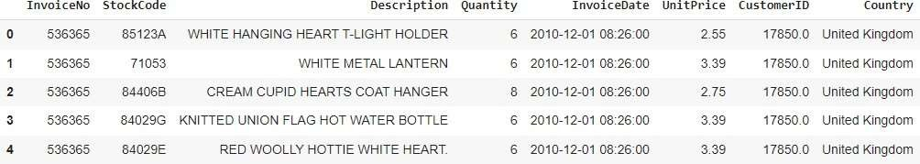
Dataset Information
→This dataset contains 541909 observations and 8 features that contain the data of between
01/12/2010 and 09/12/2011 for a UK-based and registered non-store online retail.
There are 3 categorical features in our dataset.
This dataset have null and duplicate values.

Slide 5
Feature Summary
InvoiceNo: Invoice number. Nominal, a 6-digit integral number uniquely assigned to each
transaction. If this code starts with letter 'c', it indicates acancellation.
StockCode: Product (item) code. Nominal, a 5-digit integral number uniquely assigned toeach
distinct product.
Description: Product (item) name. Nominal.
Quantity: The quantities of each product (item) per transaction. Numeric.
InvoiceDate: Invoice Date and time. Numeric, the day and time when each transaction was
generated.
UnitPrice: Unit price. Numeric, Product price per unit in sterling.
CustomerID: Customer number. Nominal, a 5-digit integral number uniquely assigned toeach customer.
Country: Country name. Nominal, the name of the country where each customer resides.

Slide 6
INSIGHTS FROM OUR DATASET
This Dataset is from the UK
In our data set there are 541909 rows, 8 columns
Four categorical features ‘InvoiceNo’, ‘Stock Code’, & ‘Description’, ‘ Country’.
There are Missing Values present on Description & CustomerID columns, Removed null values
There are Duplicate values present, Removed duplicates
One Datetime[ns] features ‘InvoiceDate’.
Outliers present only in “Quantity” & “Unit Price”column.
Removed cancelled orders.
Added new features from datetime column such as months, days, hours.
Added Total Amount
Converted data type

Slide 7
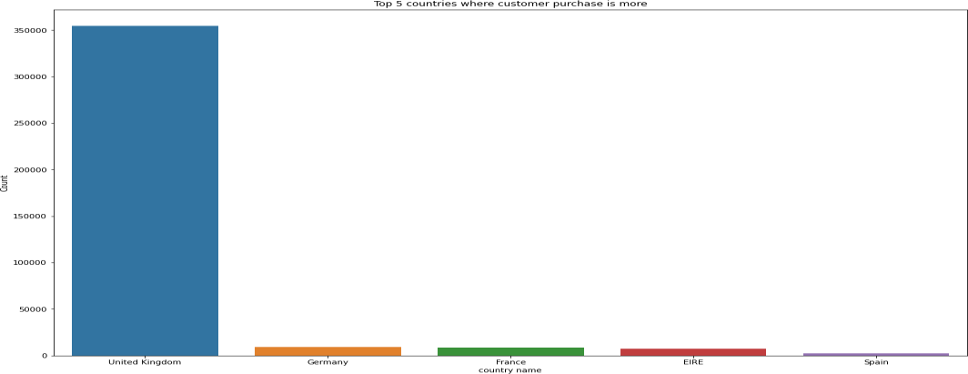
Categorical Feature Analysis Of Country column
UK, Germany, France were top countries having more no. of customers.
Since data belonged to UK based company, UK had majority of customers

Slide 8
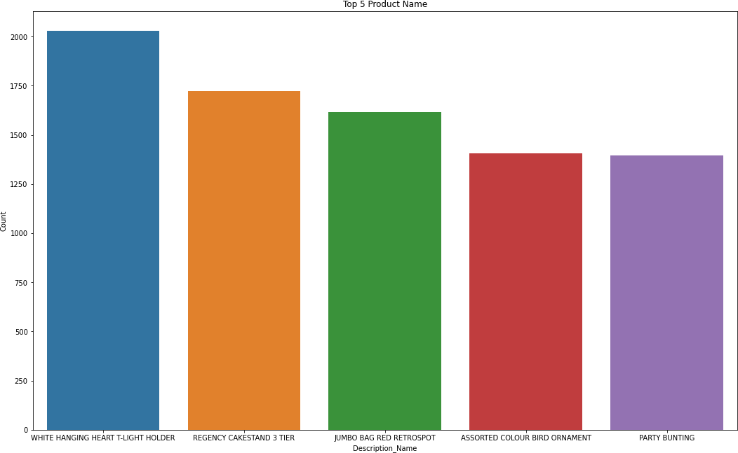
Analysis Of Product column

Slide 9
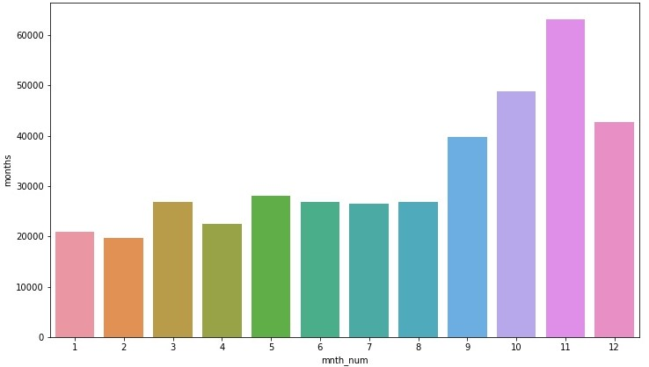
Analysis Of Month Column
November, October and December could be the months with highest sales in anticipation of Christmas

Slide 10
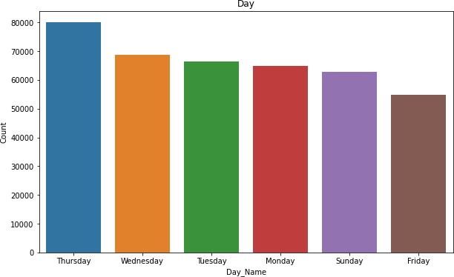
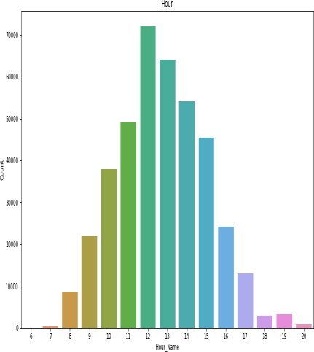
Analysis Of Day Column
Most of the customers have purchased the items in Thursday, Wednesday and Tuesday
Working hours witnessing the highest sales could be attributed to the fact that a large part of the dataset is Wholesalers’ data.

Slide 11
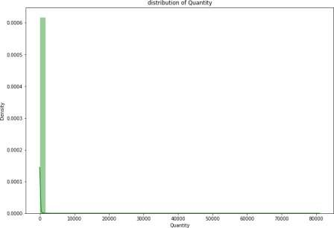
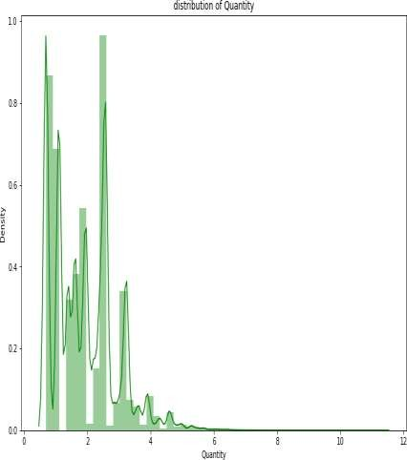
Analysis Of Numerical column
Data transformation

Slide 12
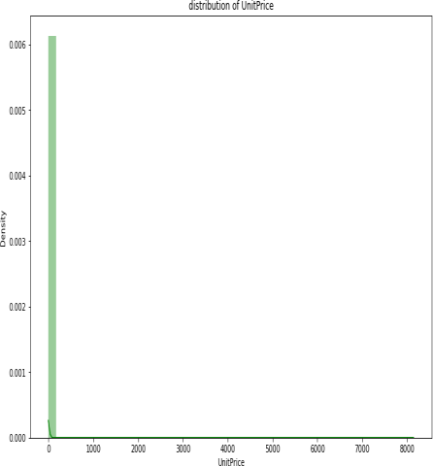
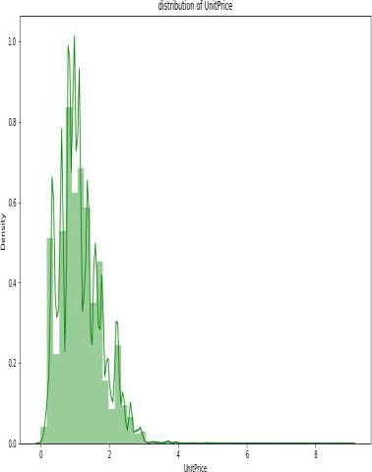
Analysis Of Numerical column
Data transformation

Slide 13
Conclusion
We can conclude that most of the customers have purchase the items in Thursday Wednesday and
Tuesday
The most numbers of customers have purchase the gifts in the month of November ,October and December September
Most of the customers have purchase the items in Afternoon ,moderate numbers of customers have
purchase the items in Morning and least numbers of customers have purchase the items in Evening
Top countries with respect to purchase are UK Germany France
Top Items are WHITE HANGING HEART T-LIGHT HOLDER,REGENCY CAKESTAND 3 TIER , JUMBO BAG RED RETROSPOT ,ASSORTED COLOUR BIRD ORNAMENT

Slide 14
RFM Segmentation
RFM stands for Recency, Frequency, and Monetary. RFM analysis is a commonly used technique to generate and assign a score to each customer based on how recent their last transaction was (Recency), how many transactions they have made in the last year (Frequency), and what the monetary value of their transaction was (Monetary).
RFM analysis helps to answer the following questions: Who was our most recent customer? How many times has he purchased items from our shop? And what is the total value of his trade? All this information can be critical to understanding how good or bad a customer is to the company.
After getting the RFM values, a common practice is to create ‘quartiles’ on each of the metrics
and assigning the required order.

Slide 15
RFM Implementation
RFM simply mean Recency, Frequency, Monetary
The RFM model is based on three quantitative factors
Frequency: How often a customer makes a purchase.
Monetary Value: How much money a customer spends on. (Sum of Total)
Recency = Latest Date - Last Invoice Data
Split into four segments using quantiles

Slide 16
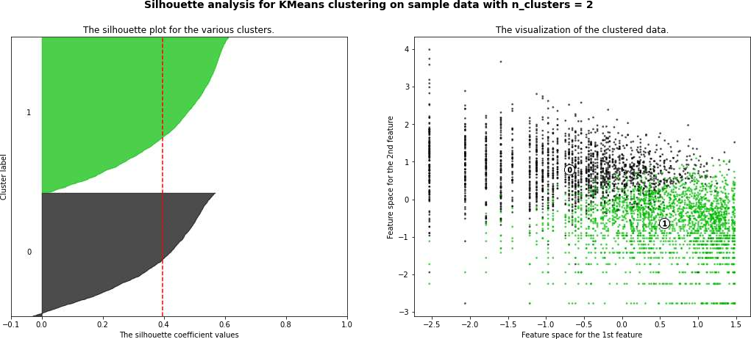
K mean clustering and Silhouette Method on Recency
,Frequency and Monetary

Slide 17
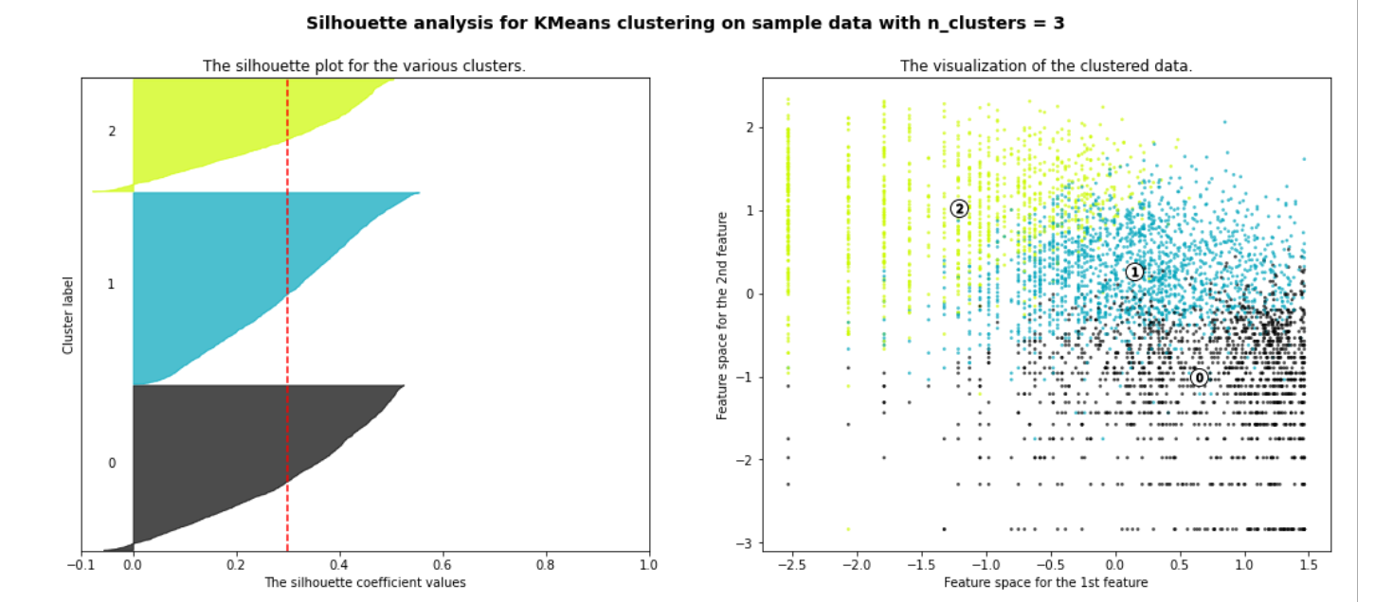
SILHOUETTE ANALYSIS ON R, F AND M

Slide 18
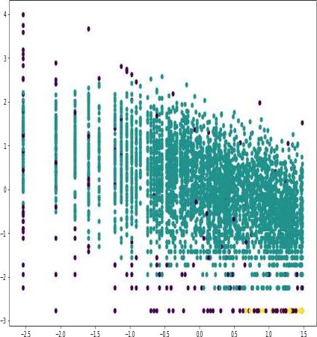
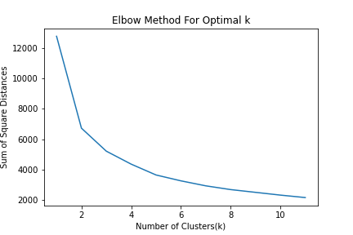
DBSCAN and Elbow method to Recency Frequency and Monetary

Slide 19

Conclusion
Throughout the analysis we went through various steps to perform customer segmentation. We started with data wrangling in which we tried to handle null values, duplicates and performed feature modifications. Next we did some exploratory data analysis and tried to draw observations from the features we had in the dataset.
Next we formulated some quantitative factors such as recency, frequency and monetary known as rfm model for each of the customers. We implemented K-Means clustering algorithm on these features. We also performed silhouette and elbow method analysis to determine the optimal no. of clusters which was 2.
We saw customers having high recency and low frequency and monetary values were part of one cluster and customers having low recency and high frequency, monetary values were part of another cluster.
We saw higher values of frequency, monetary and low values of recency is deciding one class and low values of frequency, monetary and high values of recency is deciding other class.
K-Means with silhouette_score of RFM Optimal_Number_of_cluster are 2
K-Means with Elbow methos of RFM Optimal_Number_of_cluster are 2

Slide 20


Challenges
Large Dataset to handle
Need to analyze lot of variable
Null value handling
Feature engineering
Selecting Optimum number of cluster
Deciding the flow of the presentation

Slide 21
Thank you

